Slide 1
Software Construction – Session 5
Programming – Session 24
Recursion - Carrano

Slide 2
Session 24
Queues (ADT)
Sequence Diagrams
Method calls
Sequence diagrams
Recursion

Slide 3
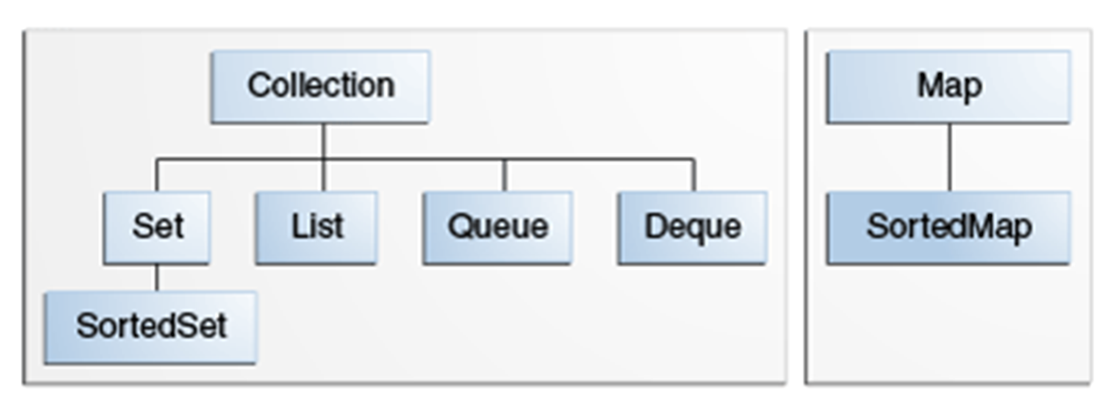
Java Collections Framework
http://docs.oracle.com/javase/tutorial/collections/index.html
Interfaces
Also known as Dictionary or Table

Slide 4
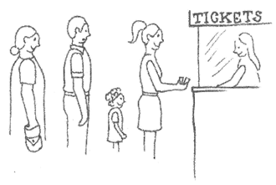
The Queue ADT
Well known structure from real life (FIFO: First In First Out)
Operations
enqueue(T newEntry) enters a new element in the back of the queue
dequeue() removes and returns the front element from the queue
getFront() returns the front element without removing it
size() returns the number of entries in the queue
isEmpty() checks if the queue is empty
clear() removes all entries

Slide 5
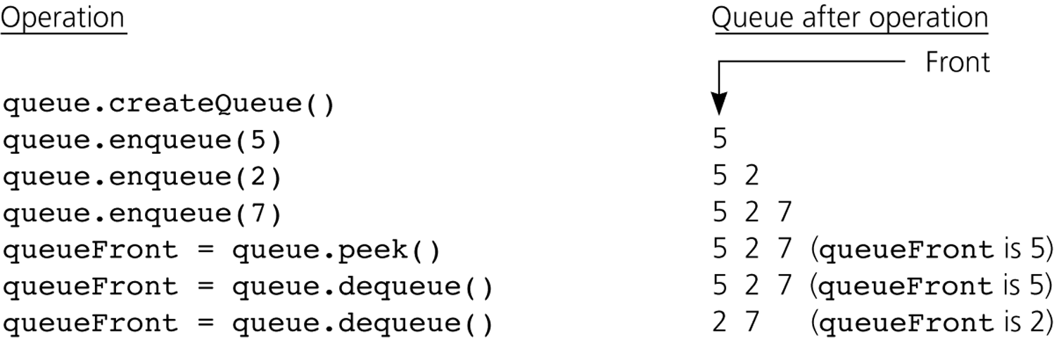
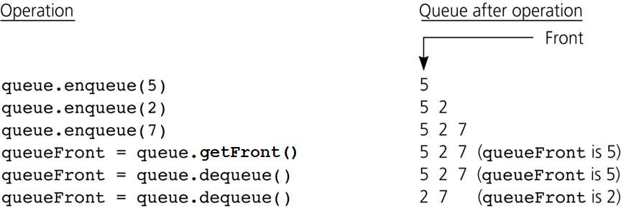
Example
???
5
2

Slide 6
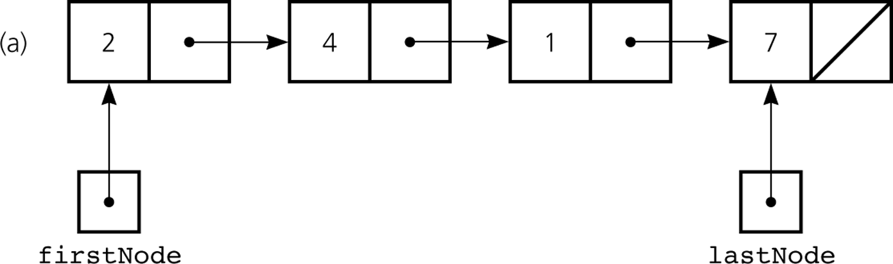
Reference Based Implementation of Queue
Using firstNode and lastNode to point to start and end of the queue

Slide 7
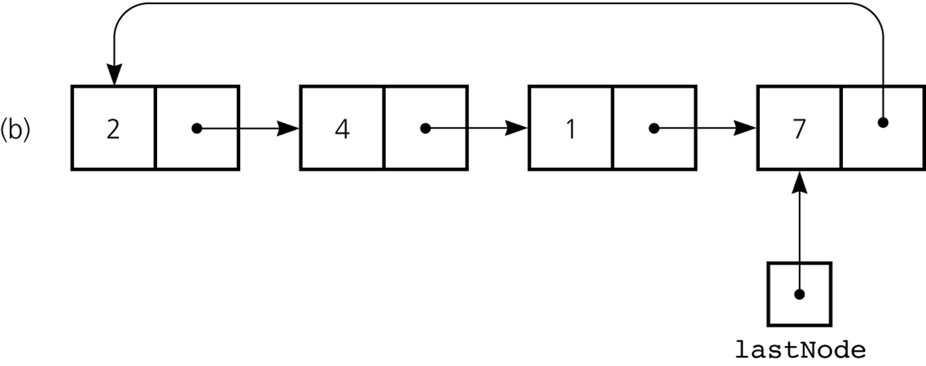
Circular linked implementation (smarter!)
Let lastNode.Next point to firstNode rather than null
firstNode is now redundant!

Slide 8
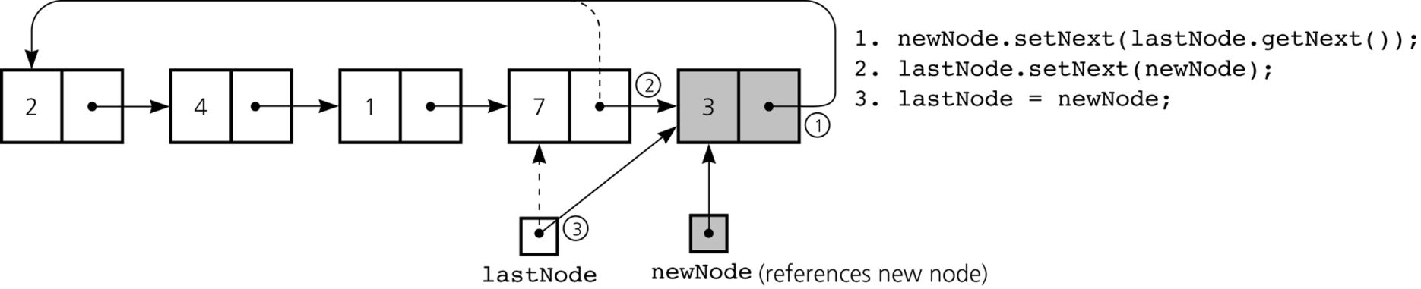
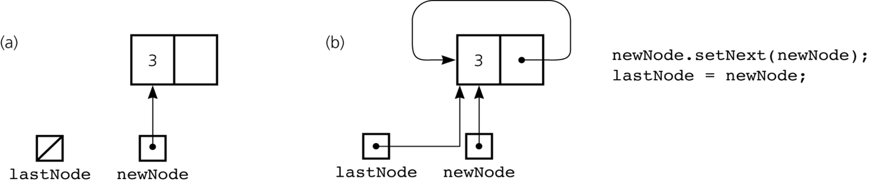
Insertion

Slide 9
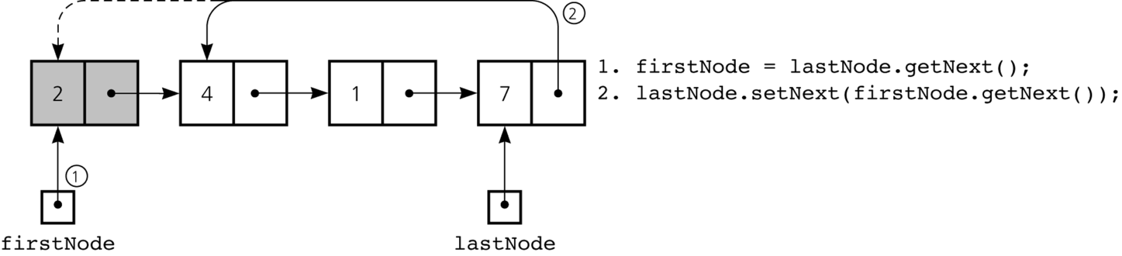
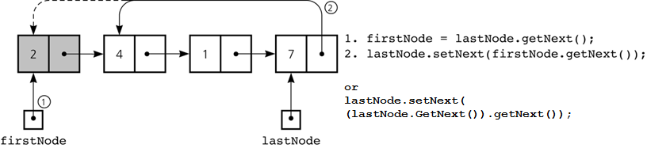
Deleting

Slide 10
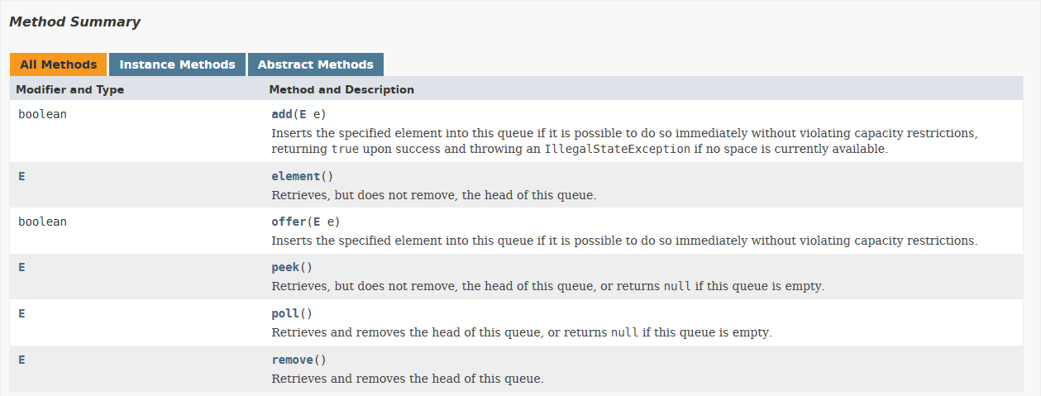
So, can we find the Queue in java.util.* ?
Let’s look at http://docs.oracle.com/javase/8/docs/api/:

Slide 11
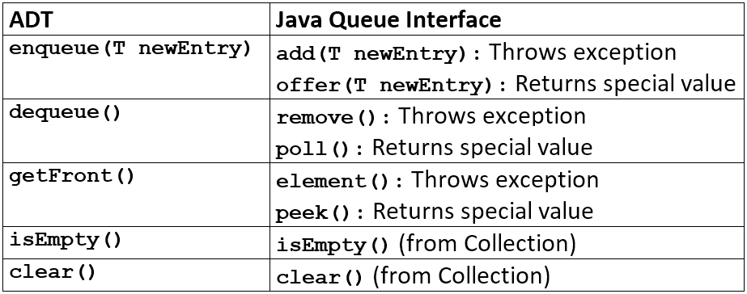
So, can we find the Queue in java.util.* ?
See note at the bottom of p. 333

Slide 12
Exercise – Optional at home
Exercise:
Implement the java.util.Queue interface using either a:
Linked implementation or
Circular implementation (see previous slides for both)
Call you class MyQueue
Create a Main class with a main method that tests your queue:
Instantiate like this: Queue q = new MyQueue();
create some objects and enter the objects into a queue,
print the queue
remove the front element
Remove and print all elements in the queue
Change your Main (start creating a copy of the old and give the copy a new name), so that the java.util.ArrayDeque is used instead of your own.
Instantiate like this: Queue q = new ArrayDeque();
Run your main method again
You should be able to observe that changing the implementation doesn’t change the behaviour of you main method if you implemented your own Queue correctly

Slide 13
The Deque (Double Ended Queue) ADT
Enqueue and dequeue at both ends
Operations (renamed a bit)
addToFront(T newEntry)
addToBack(T newEntry)
removeFront()
removeBack()
getFront()
getBack()
isEmpty()
clear()
Deque can actually be used instead of Stack – and it is recommended in Java!

Slide 14
The Priority Queue ADT
A priority is like an ordinary queue, both elements are placed not according to their arrival time, but to their priorities
E.g. Dijkstra’s algorithm may use a priority queue to always offer the closest node in the remaining graph.
Operations:
enqueue(T newEntry) enters a new element in the queue
dequeue() removes and returns the front element from the queue
getFront() returns the front element without removing it
size() returns the number of entries in the queue
isEmpty() checks if the queue is empty
clear() removes all entries
Priority queue is available in java.util.PriorityQueue:

Slide 15
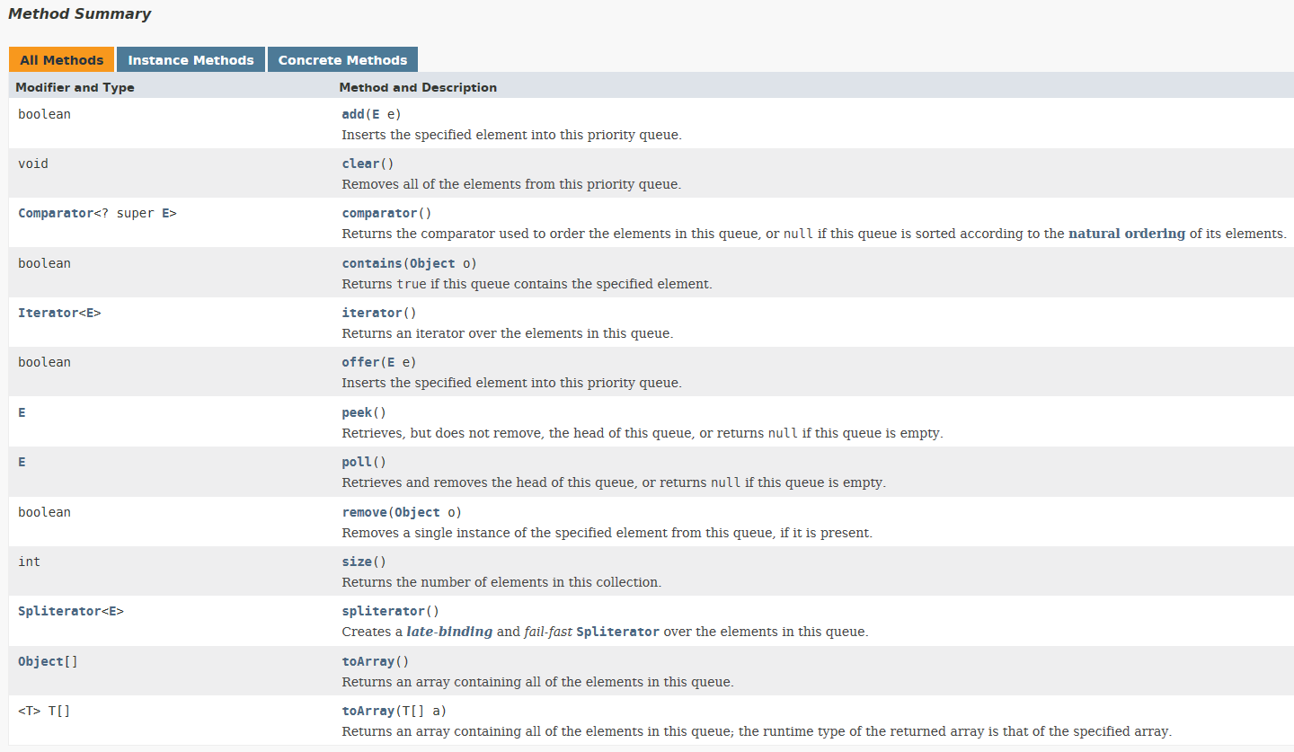
The Priority Queue ADT

Slide 16
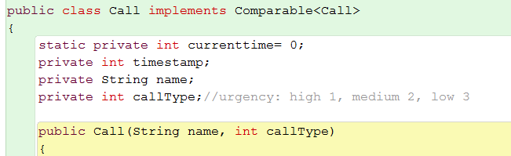

The Priority Queue ADT
Elements are ordered according to their natural order
This means that they are to implement the interface Comparable<T>
This interface specifies one method:
int compareTo(T other):
Parameters: other - the object to be compared.
Returns: a negative integer, zero, or a positive integer as this object is less than, equal to, or greater than the specified object.
a.compareTo(b)
a < b
-1 0 1
a == b
-1 0 1
a > b
-1 0 1
a – b

Slide 17
Exercise
Exercise:
Start a new Java project (BlueJ or Eclipse)
Create a Queue<String> variable
Instantiate it as an ArrayDeque
Add a number of Strings to it
Loop through the queue, poll() in each loop and print the returned value
This shows what order the values are stored in the queue
Notice how they come out in the order they were inserted
Now instantiate the same variable as a PriorityQueue
Add the same Strings to it
Loop through the queue, poll() in each loop and print the returned value
Notice what order the values are returned
Now instantiate the same variable as a PriorityQueue again
This time, pass a Comparator<String> implementation to it
Loop, poll(), print
Notice how the ordering changed (again), depending how you specified the comparable
An example could be ordering by length: return s1.length() – s2.length();

Slide 18
Method Calls
Calling a method
dog.isFeeDue(year);
Internal method call
hasDog();
this.hasDog();

Slide 19
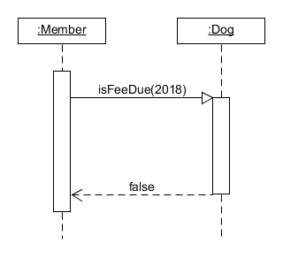
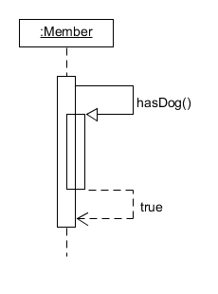
Method Calls

Slide 20
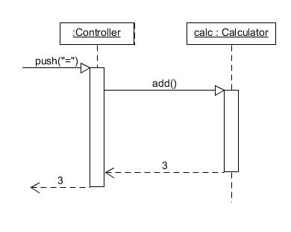
Method Call – Example in Detail
Calculator object
Perform addition
Call sequence:
User has already entered ‘1’ and ‘2’
User pushes ‘=‘
UI calls add on calc
calc returns 3
Not shown:
(UI updates itself)
(UI is ready for new input)

Slide 21
Valuation Exercise (Semantics)
<variable> = <external-method-call>;
Example: i = calc.add(a, b);
Assume: int i, a, b, and a = 1, b = 2
i = calc.add(a, b);
i→?
a→1
b→2
i = calc.add(1, 2);
i→?
a→1
b→2
public int add(x, y){
return x + y;
}
x→1
y→2

Slide 22
Valuation Exercise (Semantics)
public int add(x, y){
return x + y;
}
x→1
y→2
public int add(x, y){
return x + y;
}
x→1
y→2
public int add(x, y){
return 1 + 2;
}
x→1
y→2
public int add(x, y){
return 3;
}
x→1
y→2
add→3

Slide 23
Valuation Exercise (Semantics)
public int add(x, y){
return 3;
}
x→1
y→2
add→3
i = calc.add(1, 2);
i→?
x→1
y→2
calc.add→3
i = 3 ;
i→?
x→1
y→2
i = 3 ;
i→3
x→1
y→2

Slide 24
Recursion
Recursion: A method calls itself
Some problems are easier to understand with recursion

Slide 25
Recursion
A method is called
Check the base case
If base case: return trivial solution
It reduces the task (somehow)
Calls itself with reduced task
The recursive steps lead to the base case.
Must always be reachable, otherwise the recursion doesn’t stop
Similar to the stop condition in loops

Slide 26
Exercise: A Count Down Method
Write a recursive count down method in Java.
Calling countDown(5); should display
in the console.
Remember: No loops, the method must call itself
5
4
3
2
1
0
What is the base case?
How do you reduce the task - in the recursive step?
The output may be generated in the method, no need to return a “solution”

Slide 27
Factorial
A recursion example

Slide 28
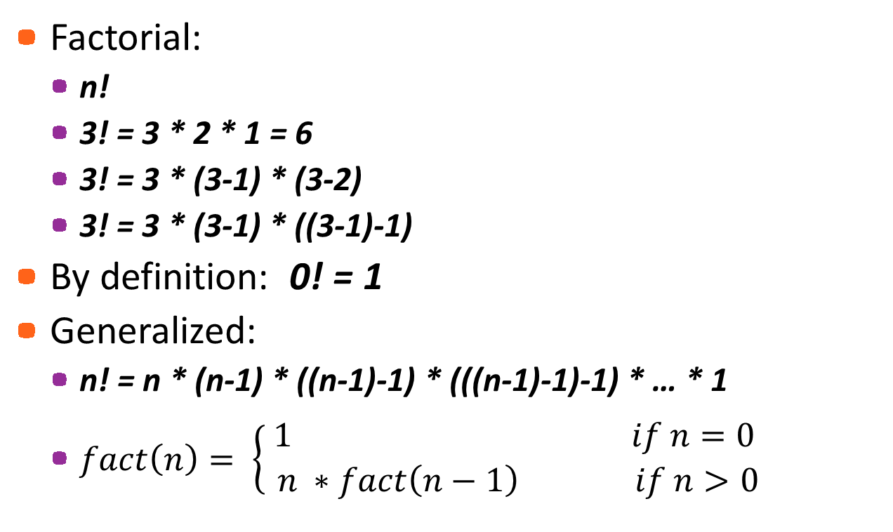
Factorial Example
Factorial:
n!
3! = 3 * 2 * 1 = 6
3! = 3 * (3-1) * (3-2)
3! = 3 * (3-1) * ((3-1)-1)
By definition: 0! = 1
Generalized:
n! = n * (n-1) * ((n-1)-1) * (((n-1)-1)-1) * … * 1
$fact\left(n\right)= \left\{\begin{aligned} 1 if n=0 \\ n ∗fact\left(n−1\right) if n>0\end{aligned}\right.$

Slide 29
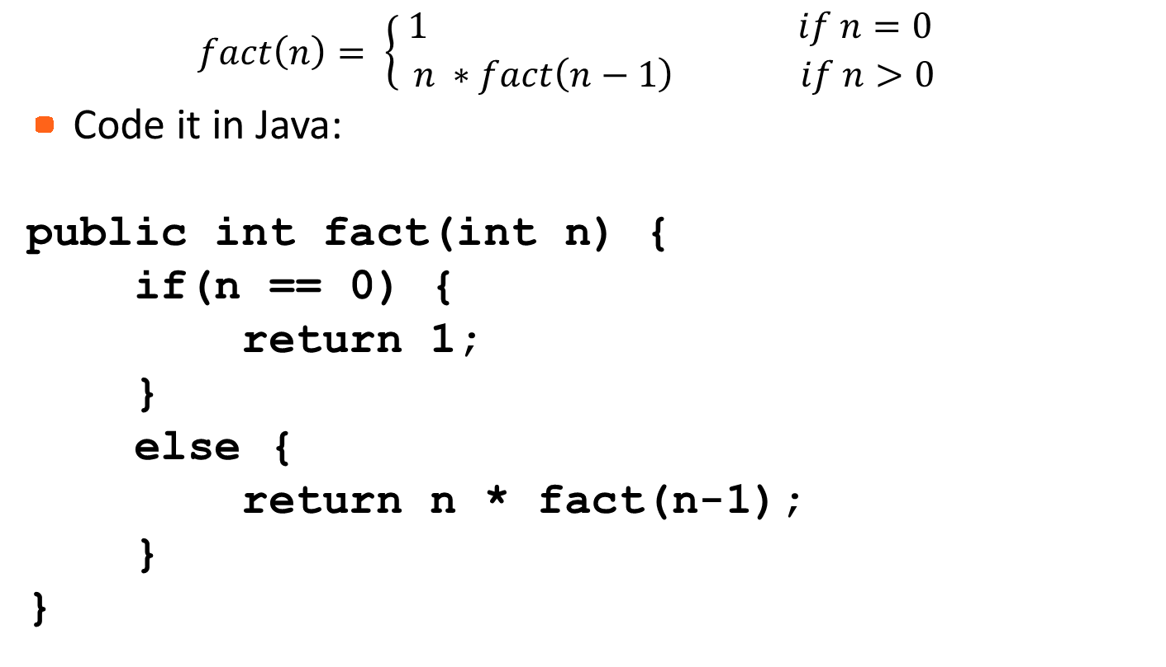
Factorial Example
$$fact\left(n\right)= \left\{\begin{aligned} 1 if n=0 \\ n ∗fact\left(n−1\right) if n>0\end{aligned}\right.$$
Code it in Java:
public int fact(int n) {
if(n == 0) {
return 1;
}
else {
return n * fact(n-1);
}
}

Slide 30
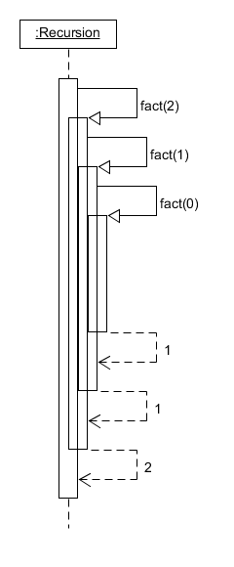
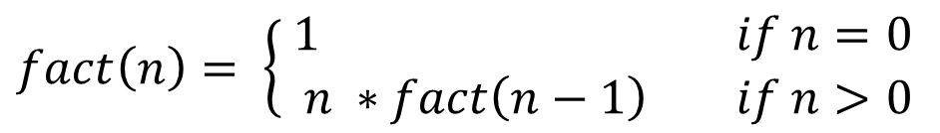
Sequence Diagram
$$fact\left(n\right)= \left\{\begin{aligned} 1 if n=0 \\ n ∗fact\left(n−1\right) if n>0\end{aligned}\right.$$
Recursive call
3! = ?
fact(3) = 3 * fact(3-1)
fact(2) = 2 * fact(2-1)
fact(1) = 1 * fact(1-1)
fact(0) = 1

Slide 31
Call Stack
Calling fact(3), the method gets a context
Activation
Pushed to the stack
fact(2) is called
New context
New activation
Pushed to the stack
Var → Val mapping is ‘isolated’ for each call

Slide 32
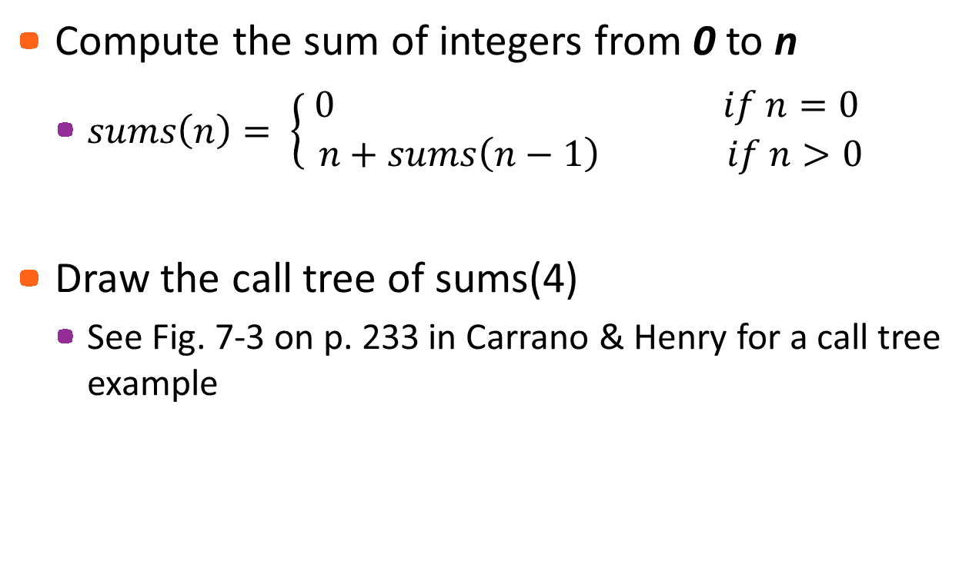
Exercise
Compute the sum of integers from 0 to n
$sums\left(n\right)= \left\{\begin{aligned} 0 if n=0 \\ n+sums\left(n−1\right) if n>0\end{aligned}\right.$
Draw the call tree of sums(4)
See Fig. 7-3 on p. 233 in Carrano & Henry for a call tree example

Slide 33
Divide, Conquer, and Combine
Recursion is often used for problems where a divide, conquer, and combine strategy can be used
Usually simpler solution
Often more resource intensive

Slide 34
Divide, Conquer, and Combine
Simple base problem: simple solution
Non-recursive
Else, divide the problem to smaller, sub-problems
Same kind
Solve each recursively
Eventually, the solution to the base problem can be applied
Combine the solutions to the sub problems

Slide 35
Example: Reversing a String
abcd → dcba
IF string is not empty
reverse the tail of the string
print the first character
ELSE
done (return)

Slide 36
Example: Reversing a String
Start
a
abcd
b
bcd
c
cd
d
d
dcba

Slide 37
Exercise: Reversing a String
public void writeReverse(String s){
if ( s.length() > 0 ) {
String sub=s.substring(1,s.length());
writeReverse(sub);
System.out.print(s.charAt(0));
}
}
Implement it and use the debugger to understand what’s happening!
Keep an eye on the call stack
Look at the local variables

Slide 38
Recursive Binary Search
The mathematician lion hunter in the desert
https://www.google.dk/search?q=santas+dirty+socks&ie=utf-8&oe=utf-8&client=firefox-b-ab&gws_rd=cr&ei=uyAqWKOzJMm7UcqPrsAI

Slide 39
Recursive Binary Search
public int binarySearch(int anArray[], int first, int last, int value) {
int index;
if (first > last) {
index = -1; // value not in original array
}
else {
int mid = (first + last) / 2;
if (value == anArray[mid]) {
index = mid; // value found at anArray[mid]
}
else
if (value < anArray[mid]) {
index = binarySearch(anArray, first, mid-1, value);
}
else {
index = binarySearch(anArray, mid+1, last, value);
}
}
return index;
}

Slide 40
Recursive Binary Search
public int binarySearch(int anArray[], int first, int last, int value) {
int index;
if (first > last) {
index = -1; // not in the array
}
else {
int mid = (first + last)/2;
if (value == anArray[mid]) {
index = mid; // value found
}
else {
if (value < anArray[mid]) {
index = binarySearch(
anArray, first, mid-1,
value);
}
else {
index = binarySearch(
anArray, mid+1, last, value);
}
}
return index;
}
binarySearch(a, 0, 6, 7)
mid = (0+6)/2 = 3
0 | 1 | 2 | 3 | 4 | 5 | 6
2 | 7 | 9 | 11 | 55 | 56 | 101
first
mid
last
first = first = 0
last = mid-1 = 3-1 = 2
binarySearch(a, 0, 2, 7)
mid = (0+2)/2 = 1
0 | 1 | 2 | 3 | 4 | 5 | 6
2 | 7 | 9 | 11 | 55 | 56 | 101
first
mid
last

Slide 41
Efficiency of Recursive Algorithms
Overhead in time due to call-return
Overhead in space due to the recursion stack
The Recursion Tree tells about complexity:
The depth tells about memory space
The number of nodes tells about running time

Slide 42
Time Complexity
O(1)
O(n)
O(n²)
O(2^{n})
O(log n)
Not a performance measurement
How the algorithm will perform as a function of its input size
Time & Space complexity

Slide 43
Tail Recursion
A loop will probably use much less memory to run
No / small call stack
If the recursive call is the very last
Tail recursion
Can be converted to a loop
If the recursive call is not the very last
Not tail recurisve
Convert to tail recursive using accumulator variables
Now it is tail recursive, it can be converted to a loop
Or: understand what happens and code a corresponding loop

Slide 44
Iterative Factorial
public long factIter(int n){
long fact = 1;
for (int i = 2; i <= n; i++){
fact = fact * i;
}
return fact;
}
public long fact(int n){
if (n == 0 || n == 1)
return 1;
else
return n * fact(n-1);
}

Slide 45
Exercises
Carrano 7 (p. 257):
Exercise 1 – 3, 5, 8
Implement the Towers of Hanoi as described in 7.30 on p. 247
Solve any unfinished exercises from today and the last session

